Slide 1
Web Application Development

Slide 2
We rely on different websites for different purposes like:
Submitting online applications
Viewing web content
Watching movies
Online shopping
Online Banking

Slide 3
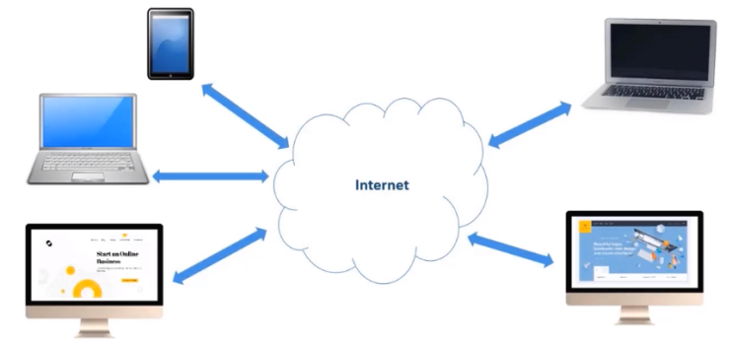
World Wide Web:
WWW is a collection of web documents and resources, which can be accessible over internet.
Internet:
An internet is a network of devices, connected to each other in order to share information.

Slide 4
A Website is a collection of web pages.
A Web page may contain text, graphics, sounds, animations and movies.
Web pages are designed using HTML (Hyper Text Markup Language).
HTML is a language of Internet.

Slide 5
How is this website made available on the Internet?
These web pages are to be stored in web Servers, connected to the internet, to be made available to the others.

Slide 6

Web Browser
A software application used to access information on the World Wide Web.

Slide 7
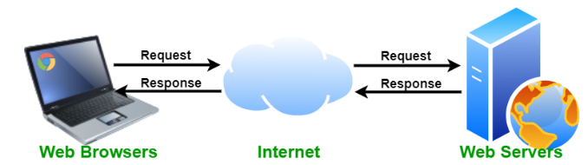
Web Server
A web server is a computer that runs websites. The web server is to store, process and deliver web pages to the users.
Apache Server, Microsoft IIS, Google Web Server

Slide 8
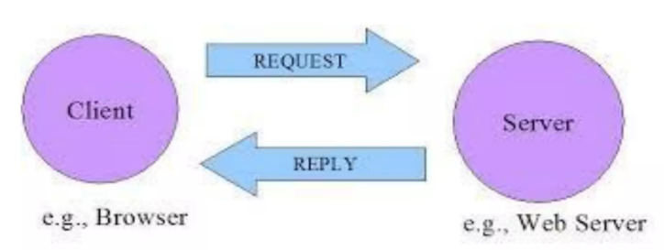
Communication on the Web

Slide 9
Communication on the Web
In order to communicate on the web, computers/devices need to understand each other.
This is made possible by making all devices follows the same protocol, namely TCP/IP.

Slide 10
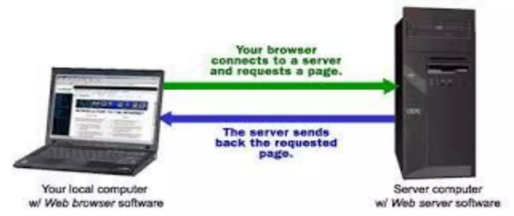
Communication on the Web can be categorized as
1. Client (browser) to Web Server

Slide 11

Communication on the Web can be categorized as
2. Web Server to Web Server Communication

Slide 12
Essential Communication over the Internet
1. Authentication: is the process of determining whether a computer/ Server is the computer that it is claims to be.
2. Security: It should be provided to communication over internet so that the messages are not intercepted and modified by hackers.

Slide 13
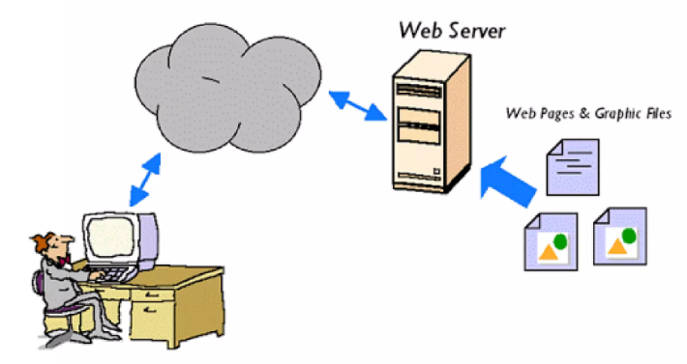
Client (Browser) to Server

Slide 14
Client (Browser) to Server
It doesnot usually require Authentication.
But in the case of web based banking applications, email services, user names and passwords are required to be sent to the server.
The information cannot be sent to the servers as plain text, due to security reasons.
The hackers may steal information, if it is communicated and shared as a plain text.

Slide 15
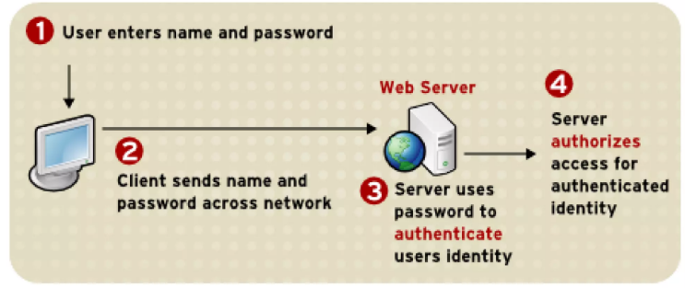
Client (Browser) to Server

Slide 16
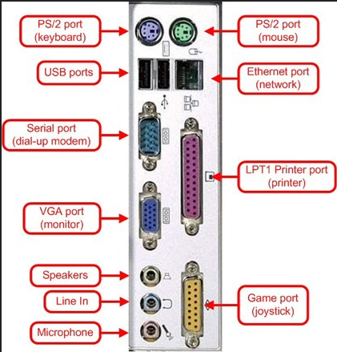
Hardware Ports
These ports are used to connect external devices to the computer.

Slide 17
Software Ports
These are used to connect a client computer to a server to access its services like HTTP, FTP, SMTP etc.
The software ports are given unique numbers.
These are used to identify the different services like e-mail, file transfer etc.

Slide 18
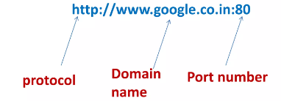
Software Ports
Port number is a 16-bit number which when added to a computers IP address/ URL, can be used for communicating with the particular service available on that server.

Slide 19
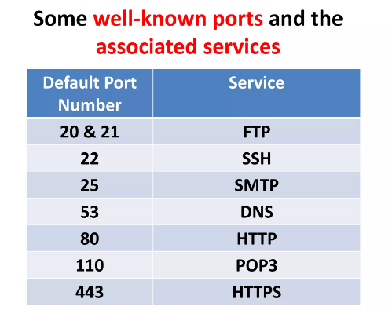

Slide 20

DNS Servers
It runs a special purpose networking software that contains a database of domain names and IP Addresses.

Slide 21
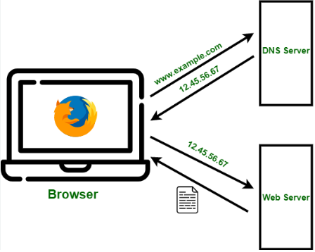

Slide 22
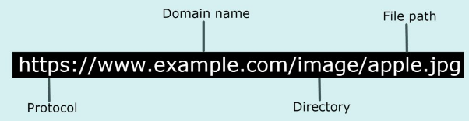
Uniform Resource Locator
URL uniquely identifies the particular resource in the internet. It has the following components:
Protocol://host:port/path

Slide 23
HTML
Hyper Text Markup Language is used to design web pages.
It defines the meaning and structure of web content.
It consists of tags and attributes used to format web pages.

Slide 24
Static Web Pages
Web pages that remain the same all the time until their code is changed manually.
It is created using HTML.

Slide 25
Dynamic Web Pages
The web pages that contain server side code which creates a web page each time it is accessed.
Program code that runs on the server is called server side code.
Ex: PHP, ASP, JSP etc.

Slide 26
HTML Document
The most widely used language to write web pages.
It is not a programming language.
It is not a case sensitive language.
Each HTML file is a plain text that defines a set of commands for creating hypertext documents. These commands are known as HTML Tags.

Slide 27

HTML
Developed by Tim Berners Lee, in 1980 at CERN, a European Particle Physics Laboratory.

Slide 28
HTML
The HTML files must be saved with .htm or .html extension.
HTML pages are viewed with the help of web browsers.
Popular web browsers are:
Microsoft Internet Explorer/Edge
Google Chrome
Mozilla Firefox
Opera..

Slide 29
Tags
Tags are generally classified into two types:
Container tag
Empty tag

Slide 30
Container tag or element
This type of HTML tag or elements require pair of tags i.e. a starting tag as well as an ending tag.
<html>…..</html>
<head>…..</head>
<title>…...</title>
<body>…..</body>

Slide 31
Empty tag/ Element
This type of tag just requires a starting tag not an ending tag.
<br>
<frame>
<img>
<hr> etc..

Slide 32
Attributes
An attribute is a special word used to provide an additional information to the tag such as color, alignment, background etc..
bgcolor
background
alignment
src
type etc..

Slide 33
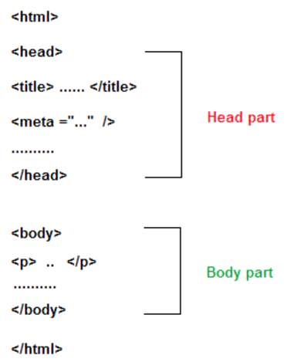
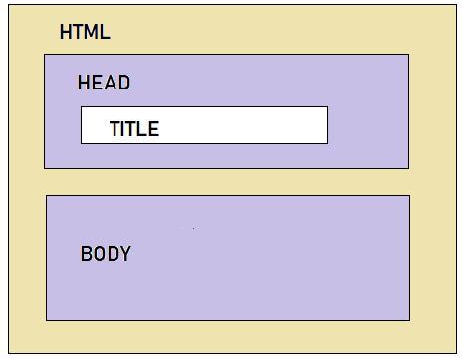
Basic Structure of HTML

Slide 34
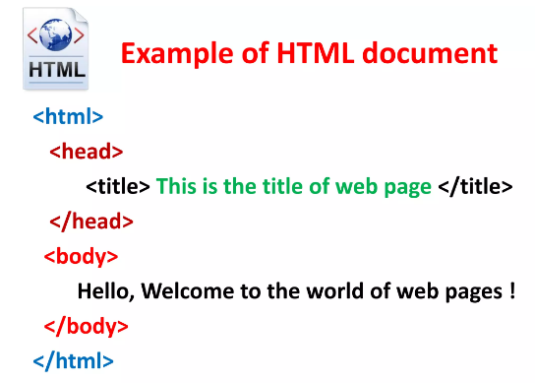

Slide 35
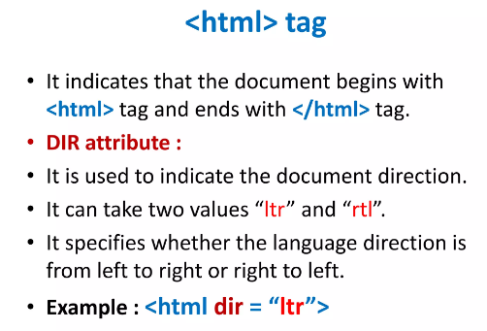

Slide 36
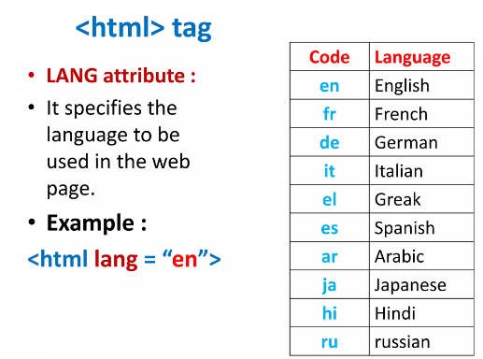

Slide 37
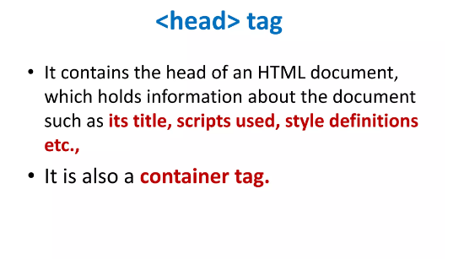

Slide 38
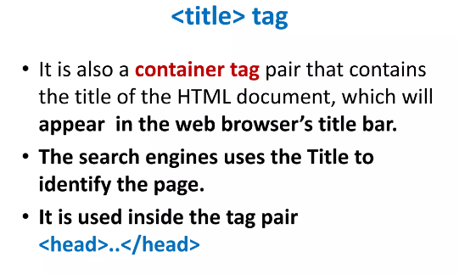

Slide 39
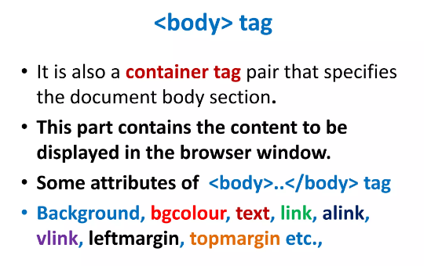

Slide 40
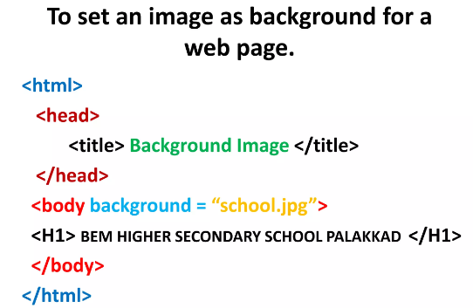

Slide 41
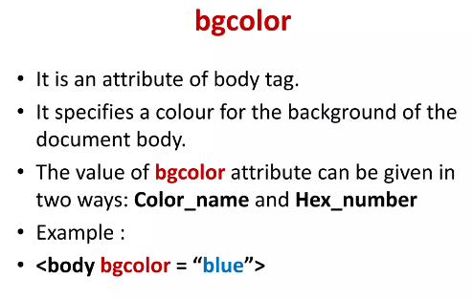

Slide 42
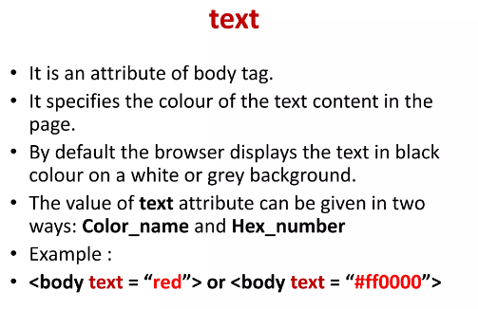

Slide 43
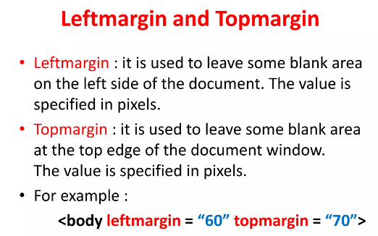

Slide 44
Formatting Tags
Used for formatting the text contents in the body section of the HTML document.
Heading Tags: (H1 to H6)
Main attribute for this tag is align. Possible values are: left, right, center.
Ex: <h1 align=“center”>Heading1</h1>
<h4 align=“right”>Heading 4</h4>

Slide 45
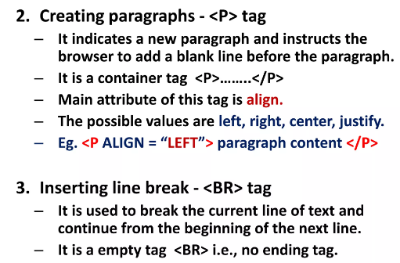

Slide 46
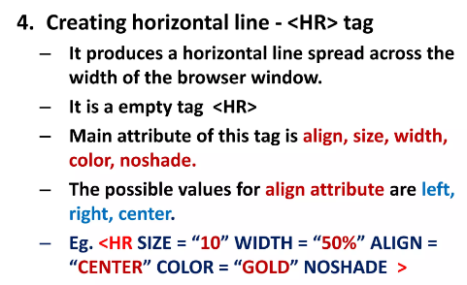

Slide 47
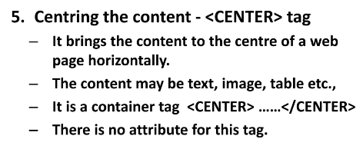

Slide 48
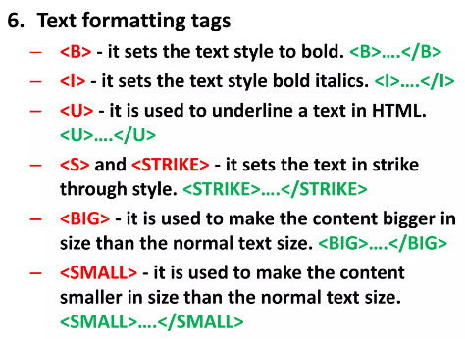

Slide 49
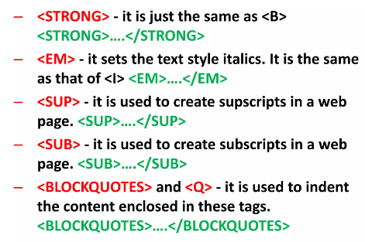

Slide 50
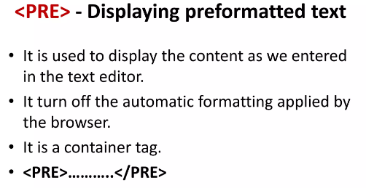

Slide 51
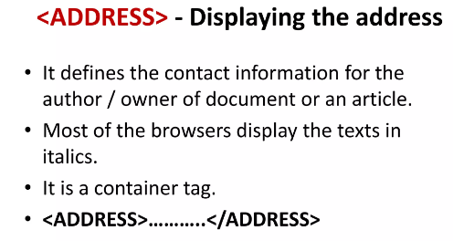

Slide 52
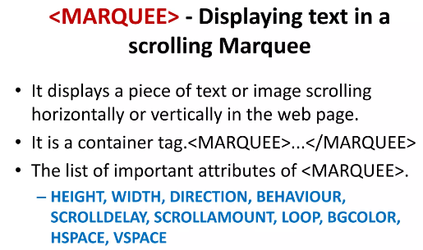

Slide 53
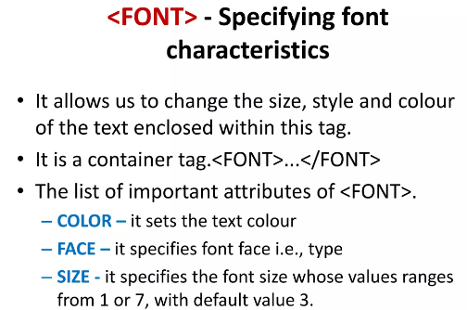

Slide 54
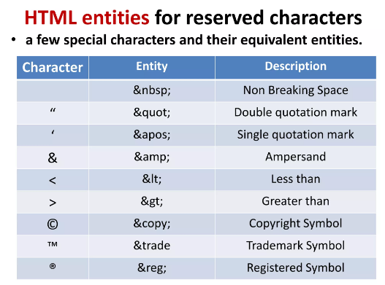

Slide 55
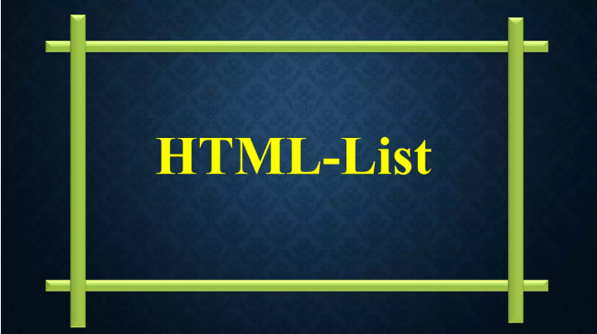

Slide 56
INTRODUCTION TO LISTS
Lists are the best way to provide information in a structured, easy-to-read format.
Lists are the best method of organizing information and presenting it in a structured fashion.

Slide 57
TYPES OF LISTS
There are three kinds of lists:
Ordered List (Numbered List)
Unordered List (Bulleted List)
Definition Lists

Slide 58
Ordered List (Numbered List)
Ordered list also called as Numbered list, is used to present a numbered list of item in the order of importance or the item(paragraph) is marked with a number.
An ordered list must begin with the <OL> followed by an <LI>list item tag.

Slide 59
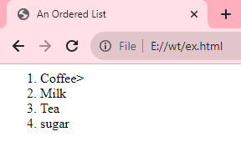
Ordered List
<HTML>
<HEAD>
<TITLE>
An Ordered List
</TITLE>
</HEAD>
<BODY>
<ol>
<li>Coffee>
<li>Milk
<li>Tea
<li>sugar
</ol>
</BODY>
</HTML>

Slide 60
Attributes of <OL> tag
TYPE : allows marking list items with different types. By default the list Item markers are set to numbers 1,2,3… so on. Other values of TYPE attribute are:
Attribute Description
Type = A Capital letter eg. A, B, C………
Type = a Small letter eg. a, b, c,………
Type = I Uppercase Roman Numbers eg. I, II, III……
Type = i Lowercase Roman Numbers eg. i, ii, iii……
Type = 1 eg. 1, 2, 3……

Slide 61
Attributes of <OL> tag
The start attribute: The attribute is used to override default list numbering when a list is divide into multiple parts. E.g:
<HTML>
<HEAD>
<TITLE>
An Ordered List
</TITLE>
</HEAD>
<BODY>
Impact printers
<ol>
<li>DOT MATRIX

Slide 62
EXAMPLE OF START ATTRIBUTE
<li>CHAIN PRINTER
<li>DRUM PRINTER
</ol>
<P>NON-IMPACT PRINTER</P>
<OL START=4>
<li>LASER PRINTER
<li>ELECTROSTATIC PRINTER
</OL>
</BODY>
</HTML>

Slide 63
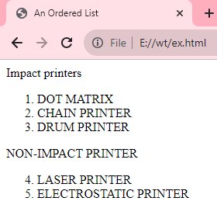
OUTPUT

Slide 64
Nested Order List
One ordered list might contain one or more ordered list that Is called as Nested Order lists.
Example:
<HTML>
<HEAD>
<TITLE> Use of Nested Ordered Lists</TITLE>
</HEAD>
<BODY>
<OL TYPE = A START =3>
<LI> Fruits
<OL TYPE = I>
<LI> Apple
<LI> MANGO
<LI> Orange
</OL>

Slide 65
<LI> VEGETABLES
<OL TYPE = I>
<LI> Brinjal
<LI> Cabbage
<LI> Tomato
</OL>
</OL>
</BODY>
</HTML>

Slide 66
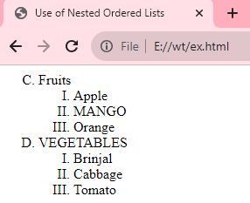
OUTPUT:

Slide 67
Unordered List <UL>
Unordered List also called as bulleted list, used to present list of items marked with bullets.
An unordered list starts with in <UL> followed by <LI> (List Item) tag.
Use of <UL> is very similar to <OL> (ordered list).

Slide 68
Use of Unordered List and Various Attributes
<HTML>
<HEAD><TITLE> Use of Unordered List </TITLE></HEAD>
<BODY>
<UL>
<LI> FRUITS
<UL>
<LI> Apple
<LI> Mango
<LI> Orange
</UL>
<LI> VEGETABLE
<UL>
<LI> Brinjal
<LI> Cabbage
<LI> Tomato
</UL>
</UL>
</BODY>
</HTML>

Slide 69
OUTPUT
FRUITS
--Apple
-Mango
-Orange
VEGETABLE
- Brinjal
-Cabbage
-Tomato

Slide 70
Definition Lists
A definition list is a list of items, with a description of each item.
The <dl> tag defines a definition list.
The <dl> tag is used in conjunction with <dt> (defines the item in the list) and <dd> (describes the item in the list).

Slide 71
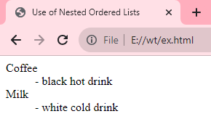
E.g.
<dl> <dt>Coffee</dt> <dd>- black hot drink</dd> <dt>Milk</dt> <dd>- white cold drink</dd> </dl>

Slide 72
INTRODUCTION HTML Hyperlinks
A hyperlink (or link) is a word, group of words, or image that you can click on, to jump to a new document or a new section within the current document.
When you move the cursor over a link in a Web page, the arrow will turn into a little hand.
HTML provides <A> Anchor Tag to create links. The format of using anchor tag is as follows:
<A HREF ="URL"> Make Me The Link </A>

Slide 73
HREF (Hyper Link Reference) is a mandatory attribute used to refer the URL of the resource.
URL (Uniform Resource Locator) is an address tells the browser about the file to link to.
It identifies file locations (Addresses) on the web or on the local hard drive.
It is always enclosed in quotes.

Slide 74
HTML Link Syntax
The HTML code for a link is simple.
<a href="url">Link text</a>
The href attribute specifies the destination of a link.
Example:
<a href= “http://www.flowers.com/”> flowers</a>
which will display like this: flowers
Clicking on this hyperlink will send the user to ‘flowers. com' homepage.

Slide 75
Linking a text to a web site / an external document
Example:
<A HREF ="http://www.nios.ac.in">Link to Website of NIOS </A>
OR
<A HREF="http://www.nios.ac.in/offices.htm">Links to Contact Us page of NIOS </A>

Slide 76
Linking (jumping) to a specific place within the same document.
Sometimes, it is required to jump different sections in the same document. For this it needs two steps, first; identify section with a name and or second; use jumps to the location using the name used.
The syntax is:
<A HREF="#section_name"> link to another section of the same document </A>
This link text jumps to the section named with HREF on click.The # symbol before the section name is must.

Slide 77
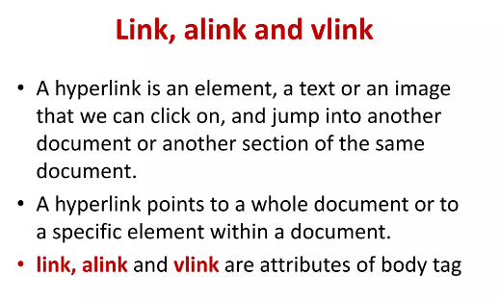

Slide 78
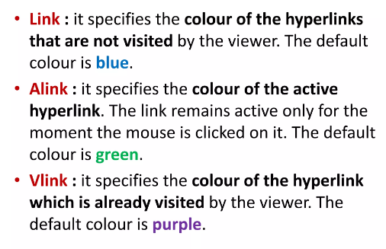

Slide 79
Using HTML Tables

Slide 80
Using HTML Tables
You can use the <table>…</table> container to display information in table format.
You can use the <table>…</table> container to control the layout of a page.

Slide 81
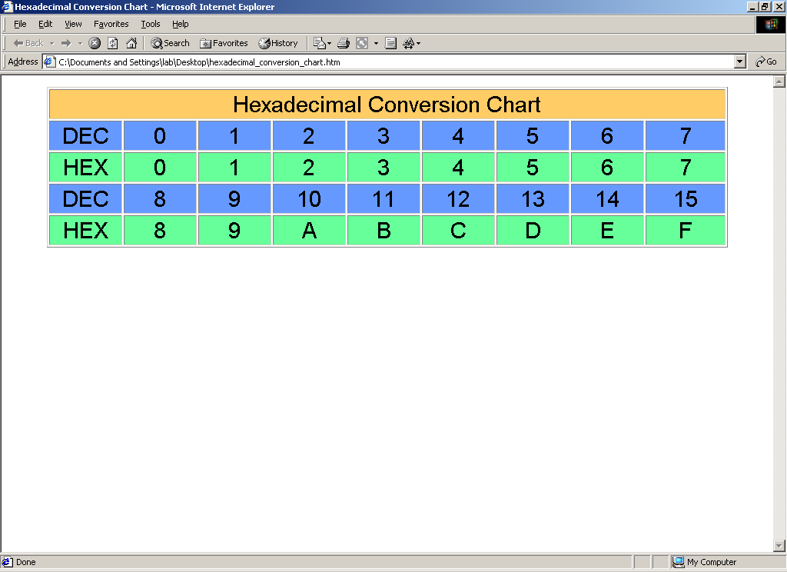
Using Tables for Information

Slide 82
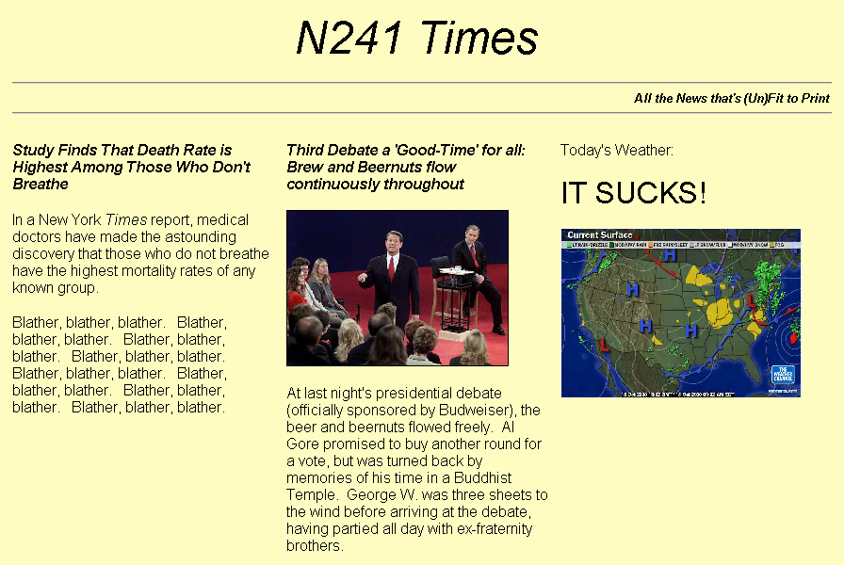
Using Tables for Layout

Slide 83
The <table>…</table> Container
Defines the beginning and end of a table
Attributes
background
bgcolor
border
cellspacing
cellpadding
width
height

Slide 84
The <tr>…</tr> Container
Defines a table row
Structural tag only (no content)
Attributes
align
valign
bgcolor

Slide 85
The <td>…</td> Container
Defines a data cell in a table
Can contain any content, including another, nested table
Attributes:
align
valign
height
background
bgcolor
height
width
colspan
rowspan

Slide 86
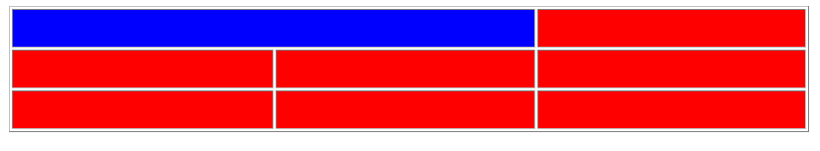
<td colspan …> Example
<tr> <td colspan=“2” bgcolor=“blue”> </td> <td> … </td> </tr>

Slide 87
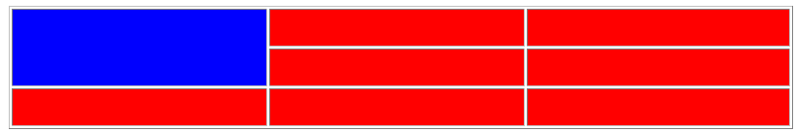
<td rowspan …> Example
<tr> <td rowspan=“2” bgcolor=“blue”> </td> <td> … </td> </tr>

Slide 88
<th>…</th> Container
Defines a header cell
Acts just like a <td>…</td> container, except …
The text is normally centered vertically and horizontally AND the text is bold
Attributes are the same as <td>…</td>

Slide 89
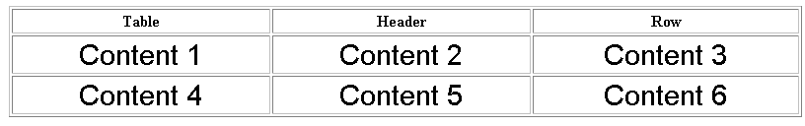
<th>…</th> Example
<tr> <th> Table </th> <th> … </th> </tr>

Slide 90
<caption>…</caption> Container
Provides a summary of the table’s purpose
MUST immediately follow <table>
Attributes:
align
summary
valign

Slide 91

<caption>…</caption> Example
<caption align=“center” summary=“Long Description goes here” valign="bottom"> Figure 1: Hexadecimal Conversions </caption>

Slide 92
<html>
<table border="3">
<caption>
Web Technologies
</caption>
<thead>
<th>Back-end JS </th>
<th>Front-end JS </th>
</thead>
<tbody>
<tr>
<td>Node</td>
<td>React</td>
</tr>
<tr>
<td>Express</td>
<td>Angular</td>
</tr>
</tbody>
</table>
</html>

Slide 93
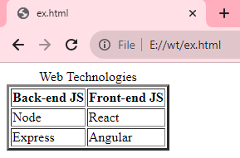
OUTPUT:

Slide 94
Editing elements – Need
While developing any content-based application, there may be a requirement to get it reviewed.
While reviewing the content of our web page, the reviewer may want to add or delete some content.
For this scenario, editing elements can be used.

Slide 95
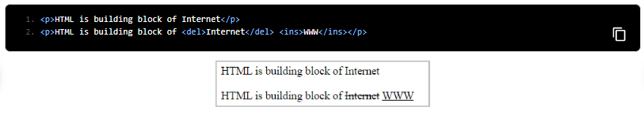
List of Editing Elements
The following are elements used for editing.
del: It defines deleted text by striking on it
ins: It defines inserted text by underlining it
Example:

Slide 96
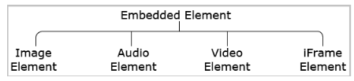
Embedded Elements
Embedding content like audio clips, videos, images, maps, and so on... are a great way of engaging, be entertaining and be able to quickly deliver information to the website users.

Slide 97
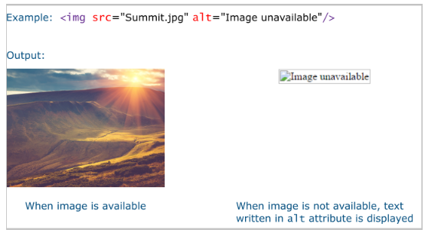
Image Element
Embedding images to a web page can be done with the <img>...</img> tag.
The <img> tag has attributes 'src' and 'alt' where src defines the location of the image and alt defines the alternative text if it is failed to load the image inside the web page.

Slide 98
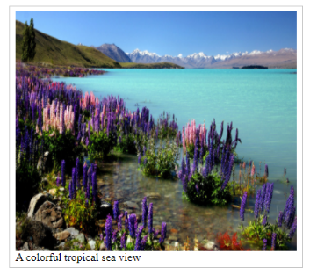
Image Captions
element <figure> along with <figcaption> element which help us to provide caption for our images.
<figure>
<img src="tropicalSea.jpg" alt="An image of tropical sea" width="400" height="341">
<figcaption>A colorful tropical sea view</figcaption>
</figure>

Slide 99
The <figure> element in HTML is commonly used along with a diagram, illustration, or image to represent them as self-contained content.

Slide 100
Embedding Video:
Here is the simplest form of embedding a video file in your webpage −
<video src = "foo.mp4" width = "300" height = "200" controls>
Your browser does not support the <video> element.
</video>

Slide 101
HTML5 - Audio & Video
You can use <source> tag to specify media along with media type and many other attributes.
A video element allows multiple source elements and browser will use the first recognized format −

Slide 102
HTML5 - Audio & Video
<video width = "300" height = "200" controls autoplay>
<source src = "D://wt/video.html" type = "video/mp4" />
Your browser does not support the <video> element.
</video>

Slide 103

HTML5 - Audio & Video

Slide 104
Video Attribute Specification
video tag can have a number of attributes to control the look and feel and various functionalities of the control.
Autoplay: This Boolean attribute if specified, the video will automatically begin to play back as soon as it can do so without stopping to finish loading the data.
Autobuffer: This Boolean attribute if specified, the video will automatically begin buffering even if it's not set to automatically play.

Slide 105
Height: specifies the height of the video's display area, in CSS pixels.
Loop: Boolean attribute if specified, will allow video automatically seek back to the start after reaching at the end.
Controls: allow the user to control video playback, including volume, seeking, and pause/resume playback.

Slide 106
Poster
This is a URL of an image to show until the user plays or seeks.
Src
The URL of the video to embed. This is optional; you may instead use the <source> element within the video block to specify the video to embed.
Width
This attribute specifies the width of the video's display area, in CSS pixels.

Slide 107
Embedding Audio
HTML5 supports <audio> tag which is used to embed sound content in an HTML or XHTML document as follows.
<audio src = "foo.wav" controls autoplay>
Your browser does not support the <audio> element.
</audio>

Slide 108
Embedding Audio
The current HTML5 draft specification does not specify which audio formats browsers should support in the audio tag. But most commonly used audio formats are ogg, mp3 and wav.

Slide 109
Embedding Audio
<audio controls autoplay>
<source src = "/html5/audio.ogg" type = "audio/ogg" />
<source src = "/html5/audio.wav" type = "audio/wav" />
Your browser does not support the <audio> element.
</audio>

Slide 110

Embedding Audio

Slide 111
Audio Attribute Specification
The HTML5 audio tag can have a number of attributes to control the look and feel and various functionalities of the control:

Slide 112
Audio Attribute Specification
Autoplay: Boolean attribute if specified, the audio will automatically begin to play.
Autobuffer: Boolean attribute if specified, the audio will automatically begin buffering even if it's not set to automatically play.

Slide 113
Audio Attribute Specification
Controls: To control audio playback, including volume, seeking, and pause/resume playback.
Loop: Boolean attribute if specified, will allow audio automatically seek back to the start after reaching at the end.
Src: The URL of the audio to embed. This is optional; you may instead use the <source> element within the video block to specify the video to embed.

Slide 114

Forms
HTML Forms, also known as Web Forms, help in capturing information from the user.
Users can key-in the details such as name, email, phone numbers, comments, dates, and other needed values using the HTML form inputs.

Slide 116

Creating Form Elements

Slide 117

Form Input elements
The form input element is used to collect details from the user.

Slide 118

Input type - text
A single-line text field. The value attribute defines the value of the input field.
Name: <input type="text" value="">

Slide 119

Input type - password
An input field can be used to enter a password.
Password: <input type="password">

Slide 120

Input type - email
An input field that accepts email addresses.
It has in-built validation for an email.
Email-Id: <input type="email">

Slide 121

Input type - number
Defines an input text box, where the user can enter only numerical input.
Gives an error on form submission if the value entered goes beyond the min and max limits and includes built-in validation to reject non-numerical values.
Attributes min and max can be used to define a boundary and step attribute value which can be used for defining the difference between consecutive numbers.
Age: <input type="number">

Slide 122
Input type - checkbox
Defines a checkbox.
The checked attribute checks that particular checkbox value.
Also, multiple checkboxes can be checked at a time.
Hobbies:
<input type="checkbox" checked> Reading
<input type="checkbox" checked> Singing
<input type="checkbox" > Dancing

Slide 123

Input type - radio
Defines a radio button.
The name attribute specifies the associated name of that radio button.
Radio buttons in a group should have the same name.
Gender: <input type="radio" name="gender" checked value="Male"> Male
<input type="radio" name="gender" value="Female"> Female

Slide 124
Input type - file
Creates a control to upload a file to the server.
Select a file: <input type="file">

Slide 125

<button> element
Defines a clickable button that can be used to submit the form.
The button can be of 3 types:
submit (default with <button> tag)
reset (to reset the form)
button (just a clickable button)
<button type="submit">Raise your query</button>

Slide 126

Input type - URL
Defines a text input that can capture any input value starting with http:// or https://. If there is a pattern mismatch, it shows an error on form submission.
Enter the website URL: <input type="url">

Slide 127

<textarea> element
Defines a multi-line text field.
It is not possible to set a default text using the value attribute. Hence, default text can be placed into <textarea>…</textarea> tag.
Write your comments: <textarea rows="4" cols="10" >Default value</textarea>

Slide 128
Input type: Hidden
You may want to submit supplementary data (such as users' language of user input) to the server, without any user interaction.
This can be done using a hidden element.
<input type="hidden" name="Language" value="English"/>

Slide 129

Label
The <label> element is used to associate a text label with a form <input> field.
Additionally, the "for" attribute of the label can point to the "id" of input control.
This ensures the cursor focuses on the respective input control on the click of the label.

Slide 130

Color Picker
Defines a color picker.
Choose a color: <input type="color">

Slide 131

Input type - date
Creates a date-picker which is used to collect dates.
Date of Birth: <input type="date">

Slide 132

Input type – datetime-local
Defines a date-time picker, where the user can pick a date as well as time
Choose a date and time:
<input type="datetime-local"/>

Slide 133

Input type – week
Defines a date picker, where the user can pick a week.
Select a week: <input type="week"/>

Slide 134

Input type – month
Defines a date picker, where the user can pick a month.
Select a month: <input type="month"/>

Slide 136
Select and Datalist Elements
To collect input data from user as a drop-downs.
<select> element :
Defines a drop-down list.
The "multiple" attribute can be used for having a multi-select dropdown menu.
Country code: <select >
<option value="">-- Please choose a country code --</option>
<option value="+213">+213</option>
<option value="+91">+91</option>
<option value="+244">+244</option>
<option value="+61">+61</option>
<option value="+973">+973</option>
</select>

Slide 137

Select and Datalist Elements

Slide 138
<datalist> element
Defines a set of pre-defined options available to choose for an <input> element.
In the below example list attribute holds lists of possible options, the value assigned to the list attribute of the input element and id attribute of datalist attribute should be the same and the value sent to the server should be assigned to the option element value attribute.
Country:<input list="countries">
<datalist id="countries">
<option value="India">
<option value="France">
<option value="Singapore">
<option value="Thailand">
<option value="United Arab Emirates">
<option value="United States of America"></datalist>

Slide 139

The <datalist> tag the user can enter its own input and add that as an option with the help of the <input> element whereas the <select> tag doesn't provide this feature.

Slide 140

Input type – range
Defines a range slider, where the user can select input.
Volume: <input type="range"/>

Slide 141
Meter
Can be used to represent a scalar measurement within a known range.
Disk usage: <meter min="0" max="100" value="50"></meter>

Slide 142
Progress
Can be used to represent the progress of a task.
Task completed: <progress min="0" max="100" value="50">50 of 100</progress>
Note: <progress> can be used to mark up the completion rate/degree of progress of an "in progress" task through a progress bar. Whereas, <meter> is used to represent a gauge or to represent a measurement in a known scale.

Slide 143

Output Element
Displays the output of user input.
For example, consider the below code snippet:
<form oninput= "result.value=parseInt(a.value)+parseInt(b.value)">
<input type="number" id="b" name="b" value="10" /> +
<input type="number" id="a" name="a" value="10" /> =
<output name="result" for="a b">20</output></form>
The 'oninput' attribute carries the logic of generating the output, and the 'for' attribute of <output> tag specifies the control for which output has to be calculated.

Slide 144
Input Elements : Attributes
Placeholder
Pattern
Min
Max
Step
Required
Multiple
Form-override
Note: A disabled attribute can be used with any input type to restrict user interaction.
For example, a button can be made non-clickable, Checkbox can be made non-selectable.

Slide 145

Placeholder
The placeholder attribute specifies a value that appears in the textbox as below:
First name: <input type="text" placeholder="Enter your first name"/>

Slide 146

Pattern
The pattern attribute creates a custom pattern validator.
The value entered by the user is checked for validity against a specified pattern.
If the user input value does not match with a specified pattern, an error message appears.
Username: <input type="text"
pattern="[A-Za-z]"/>

Slide 147

Min, Max, and Step
which are used only with range and number input types
min: Specifies a minimum acceptable value.
max: Specifies maximum acceptable value.
step: Specifies a difference of consecutive values when the user uses the range/number input element.
Job experience: <input type="number" min="2" max="10" step="1"/>

Slide 148

Required
The required attribute specifies that user input is a must.
If the user does not enter any value, a default error message appears on the screen.
Username: <input type="text" required/>
Username: <input type="password" required/>

Slide 149

Multiple
The multiple attribute value allows the user to enter/select/upload more than one value.
<input type="file" multiple/>

Slide 150
Form-Override
The override attributes can be used to override the form-level built-in attribute functionalities using the submit/image input elements.
Form-override attribute | Description
Formaction | Overrides the form action attribute
formnovalidate | Overrides the form novalidate attribute
Formmethod | Overrides the form method attribute
Formtarget | Overrides the form target attribute

Slide 151
In the below example, you can observe that the default form submission method 'GET' has been overridden to the 'POST' method due to the usage of 'formmethod' attribute in the submit input tag.
<form method="GET" action="">
<input type="submit" formmethod="POST">
</form>

Slide 152
Need of novalidate attribute
To test the form's functionality we may want to temporarily by-pass in-built validations done by form input type elements. This can be done by novalidate attribute.
For example, if we want to bypass an email validation, you can use the below code:
<form novalidate action='xyz.html'>
<input type="email"/>
<input type ="submit">
</form>

Slide 153
iframe element
The HTML <iframe> tag specifies an inline frame.
An inline frame is used to embed another document within the current HTML document.
Syntax: <iframe src="url" title="description"></iframe>
Tip: It is a good practice to always include a title attribute for the <iframe>. This is used by screen readers to read out what the content of the iframe is.
Iframe - Set Height and Width
Use the height and width attributes to specify the size of the iframe. The height and width are specified in pixels by default.

Slide 154
Example
<!DOCTYPE html>
<html>
<body>
<h2>HTML Iframes</h2>
<p>You can use the height and width attributes to specify the size of the iframe:</p>
<iframe src="demo_iframe.htm" height="200" width="300" title="IframeExample"></iframe>
</body>
</html>

Slide 155

Or you can add the style attribute and use the CSS height and width properties:
Example
<iframe src="demo_iframe.htm" style="height:200px;width:300px;" title="Iframe Example">
</iframe>

Slide 156

Iframe - Remove the Border
By default, an iframe has a border around it. To remove the border, add the style attribute and use the CSS border property:
Example
<iframe src="demo_iframe.htm"
style="border:none;" title="Iframe Example">
</iframe>

Slide 157

With CSS, you can also change the size, style and color of the iframe's border:
Example
<iframe src="demo_iframe.htm"
style="border:2px solid red;" title="Iframe Example"></iframe>

Slide 158
Iframe - Target for a Link
An iframe can be used as the target frame for a link. The target attribute of the link must refer to the name attribute of the iframe:
Example
<iframe src="demo_iframe.htm" name="iframe_a" title="Iframe Example"></iframe> <p><a href="https://www.w3schools.com" target="iframe_a">W3Schools.com</a></p>

Slide 159


Slide 160


Slide 161
Frame element:
To divide the web browser window into multiple sections where each section can be loaded separately.
A frameset tag is the collection of frames in the browser window.
Creating Frames: Instead of using body tag, use frameset tag in HTML to use frames in web browser.
Not Supported in HTML5.
The <frameset> tag was used in HTML 4 to define a frameset.

Slide 162

<html>
<frameset rows="*,*">
<frame src="iframe.html">
<frame src="iframe1.html">
</frameset>
</html>

Slide 163
<html>
<frameset rows="*,*">
<frame src="iframe.html">
<frameset cols="20%,*,10%">
<frame src="unlist.html">
<frame src="tbl.html">
<frame src="links.html">
</frameset>
<frame src="iframe1.html">
</frameset>
</html>

Slide 164


Slide 165
HTML5 - SVG
SVG stands for Scalable Vector Graphics
Defines the graphics in XML format.
Every element and every attribute in SVG files can be animated
SVG is a W3C recommendation
SVG integrates with other W3C standards such as the DOM and XSL

Slide 166
HTML5 - SVG
SVG is mostly useful for vector type diagrams like Pie charts, Two-dimensional graphs in an X,Y coordinate system etc.

Slide 167
SVG Advantages
SVG images can be
created and edited with any text editor
searched, indexed, scripted, and compressed
printed with high quality at any resolution
zoomable
SVG graphics do NOT lose any quality if they are zoomed or resized
SVG is an open standard

Slide 168
HTML5 − SVG Circle
The <circle> element is used to create a circle.
An SVG image begins with an <svg> element
The width and height attributes of the <svg> element define the width and height of the SVG image
The cx and cy attributes define the x and y coordinates of the center of the circle. If cx and cy are omitted, the circle's center is set to (0,0)

Slide 169
HTML5 − SVG Circle
The r attribute defines the radius of the circle.
The stroke and stroke-width attributes control how the outline of a shape appears.
The fill attribute refers to the color inside the circle.

Slide 170
HTML5 − SVG Circle
<svg height="700" width="800">
<circle cx="70" cy="70" r="40" stroke="blue" stroke-width="10" fill="yellow" />
Sorry, your browser does not support inline SVG.
</svg>

Slide 171

HTML5 − SVG Circle

Slide 172
HTML5 − SVG Rectangle
<svg height="800" width="800">
<rect height="200" width="100" stroke="green" stroke-width="10" fill="yellow" />
Sorry, your browser does not support inline SVG.
</svg>

Slide 173

HTML5 − SVG Rectangle

Slide 174
HTML5 − SVG Line
HTML5 draw a line using <line> tag –
The x1 attribute defines the start of the line on the x-axis
The y1 attribute defines the start of the line on the y-axis
The x2 attribute defines the end of the line on the x-axis
The y2 attribute defines the end of the line on the y-axis

Slide 175
HTML5 − SVG Line
<svg height="800" width="800">
<line x1="10" y1="10" x2="140" y2="170" stroke="green" stroke-width="2" fill="yellow" />
Sorry, your browser does not support inline SVG.
</svg>

Slide 176

HTML5 − SVG Line

Slide 177
HTML5 − SVG Ellipse
The <ellipse> element is used to create an ellipse.
An ellipse is closely related to a circle. The difference is that an ellipse has an x and a y radius that differs from each other, while a circle has equal x and y radius

Slide 178
HTML5 − SVG Ellipse
<svg height="140" width="500">
<ellipse cx="120" cy="60" rx="70" ry="40" style="fill:yellow; stroke:purple;stroke-width:2" />
</svg>

Slide 179

HTML5 − SVG Ellipse

Slide 180
HTML5 − SVG Polygon
The <polygon> element is used to create a graphic that contains at least three sides.
Polygons are made of straight lines, and the shape is "closed" (all the lines connect up).
Polygon comes from Greek. "Poly" means "many" and "gon" means "angle".
The points attribute defines the x and y coordinates for each corner of the polygon

Slide 181
HTML5 − SVG Polygon
<svg height="210" width="500">
<polygon points="200,10 250,190 160,210" style="fill:lime; stroke:purple;stroke-width:1" />
</svg>

Slide 182

HTML5 − SVG Polygon

Slide 183
Thank You

